Slide 1
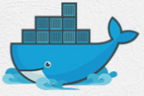
10 Docker Containers
Peter H. Chen

Slide 2
10 Docker Containers
https://www.youtube.com/watch?v=Rv3DAJbDrS0&list=PLhW3qG5bs-L99pQsZ74f-LC-tOEsBp2rK&index=10
Docker Containers
What are Containers?
How to create Containers?
Ho to start/stop Containers?
Basic Commands:
> docker ps
> docker run <image-name>
> docker start <container-name/ID>
> docker stop <container-name/ID>

Slide 3
End of Chapter

